Slide 1

CodeGalaxy: An Agentic AI Based Interactive Programming Learning Platform
By
2311CS040064
2311CS040003
2311CS040006
Harsh Kumar
Abhishek Pratap
Aditya Raj
Department of Cyber Security
School of Engineering
Malla Reddy University
Hyderabad, Telangana, INDIA

Slide 2
ABSTRACT
CodeGalaxy is an Agentic AI-powered interactive programming learning platform designed to help beginners understand programming concepts through visualization and intelligent guidance. Traditional learning methods often focus on syntax and output but fail to explain the internal execution of programs. CodeGalaxy allows users to write code in languages like Java, Python, and JavaScript, while AI agents analyze, explain, and visualize the complete program execution process. The platform uses multiple AI agents, including a Code Analysis Agent for detecting errors and suggesting improvements, a Visualization Agent for showing real-time execution steps, and a Learning Assistant Agent for providing personalized guidance. The Assessment Agent evaluates user skills and generates suitable coding challenges based on performance. By combining Agentic AI, real-time visualization, and gamification features such as levels, rewards, badges, and progress tracking, CodeGalaxy creates an engaging learning environment. It helps students build strong programming concepts, improve problem-solving skills, and learn coding through AI-driven assistance instead of only memorizing programs.

Slide 3
1. Introduction
1.1 Problem Definition
Many beginners face difficulties in understanding programming concepts because traditional learning methods mainly focus on syntax and output rather than explaining the internal working of programs. Complex topics such as loops, recursion, algorithms, data structures, and memory management are difficult to learn without proper visualization of program execution. Existing coding platforms provide limited support by only showing errors or final outputs, making it challenging for students to identify logical mistakes and understand the flow of code. Additionally, traditional learning approaches do not provide personalized guidance based on individual performance, which reduces learning effectiveness and motivation. Therefore, there is a need for an Agentic AI-based programming platform that can analyze user code, explain execution steps, visualize programming concepts in real time, provide intelligent feedback, generate personalized challenges, and create an engaging learning environment through gamification. CodeGalaxy aims to solve these problems by combining AI-driven assistance, visualization, and interactive learning to help beginners develop strong programming skills and conceptual understanding.
Description
Code Galaxy is an Agentic AI-powered interactive programming learning platform designed to make computer science education more engaging, practical, and concept-oriented. Unlike traditional learning methods that focus primarily on syntax memorization, Code Galaxy emphasizes execution-first learning by enabling students to visualize how programs execute in real time. Through a cloud-based IDE with secure sandboxed code execution, the platform dynamically displays memory allocation, variable changes, call stack operations, and program flow, helping learners develop a strong understanding of the internal behavior of code. It also integrates intelligent AI agents that analyze code, provide contextual hints, identify logical errors without revealing complete solutions, and generate personalized learning challenges based on individual progress. Supporting multiple programming languages such as Java, Python, and JavaScript, Code Galaxy combines interactive visualizations, real-time execution, gamification, and skill analytics to create an immersive learning experience that enhances problem-solving abilities, improves programming confidence, and builds a solid foundation in software development.

Slide 4
1. Introduction
1.2 Objectives of the Project
Develop an Agentic AI-powered interactive programming learning platform.
Enable execution-first learning through real-time code execution visualization.
Visualize memory allocation, call stack, variables, and program flow for better conceptual understanding.
Provide AI-powered code analysis and contextual hints without revealing complete solutions.
Support multiple programming languages such as Java, Python, and JavaScript.
Ensure secure cloud-based code execution using sandboxed environments.
Enhance debugging, logical thinking, and problem-solving skills.
Offer personalized learning paths through performance analytics and adaptive assessments.
Increase engagement using gamification, coding challenges, and skill progression.
Build strong programming fundamentals and prepare students for real-world software development.

Slide 5
2. System Analysis
  2.1 Existing System
    Background & Literature Survey
      Traditional programming platforms mainly focus on syntax and theory rather than program execution.
      Most coding platforms provide code execution but lack visualization of memory, variables, and call stacks.
      Beginners often struggle with debugging and understanding runtime behavior.
      AI coding tools mostly generate code instead of improving conceptual learning.
      Existing systems offer limited personalization and interactive learning, creating a need for an AI-powered execution-based learning platform.
    Limitations of Existing System
      Focus mainly on syntax memorization rather than conceptual understanding.
      Lack real-time visualization of program execution, memory, and call stacks.
      Provide limited personalized guidance for learners.
      AI tools often give direct solutions, reducing independent problem-solving.
      Offer low engagement with minimal interactive and gamified learning features.

Slide 6
2. System Analysis
  2.2 Proposed System
    Advantages of Proposed System
      Provides real-time code execution visualization for better understanding of program behavior.
      Offers AI-based personalized guidance and intelligent error detection.
      Improves debugging and problem-solving skills through interactive learning.
      Supports multiple programming languages like Java, Python, and JavaScript.
      Provides secure cloud-based code execution with sandbox environments.
      Enhances engagement through gamification, challenges, and progress tracking.
      Delivers a complete learning experience by combining coding, AI assistance, and analytics.
  2.3 Software & Hardware Requirements
    Software Requirements
    Node.js: Backend JavaScript runtime environment for building real-time applications.
    Express.js: Framework for building RESTful APIs and handling HTTP requests.
    React.js: Frontend library for building interactive and dynamic user interfaces.
    MongoDB: NoSQL database for storing user data, sessions, tasks, and project details.

Slide 7
2. System Analysis
  2.4 Feasibility Study
  Technical Feasibility: Uses React.js, Node.js, Python, AI (LLMs), Docker, and MongoDB, making the project technically feasible.
  Operational Feasibility: Provides an easy-to-use AI-powered learning platform for students and beginners.
  Economic Feasibility: Developed using open-source technologies and affordable cloud services, making it cost-effective.
  Schedule Feasibility: Can be completed within the planned timeline using a modular development approach.
  Educational Feasibility: Enhances programming skills through AI guidance, code visualization, and personalized learning.

Slide 8
3. Architectural Design
  3.1 Modules Design
    User Management: This module manages user registration, login, profiles, and learning progress. It stores user information and tracks achievements, completed challenges, and coding history.
    AI-Powered Code Editor: Provides an interactive code editor where users can write Java, Python, and JavaScript programs. AI analyzes the code, detects errors, and suggests improvements in real time.
    Code Execution & Visualization: Executes user programs securely inside a sandbox environment and displays step-by-step execution. It visualizes variables, loops, memory, and data structures to improve understanding.
    AI Learning Assistant: Acts as an intelligent programming tutor by answering coding questions, explaining concepts, and providing personalized learning recommendations based on user performance.
    Gamification & Challenges: Motivates learners through coding challenges, badges, rewards, experience points (XP), and levels. AI generates personalized challenges according to the learner's skill level.
    Analytics & Reports: Monitors coding activity, learning progress, and performance. It identifies weak areas and provides reports with AI-based improvement suggestions.

Slide 9
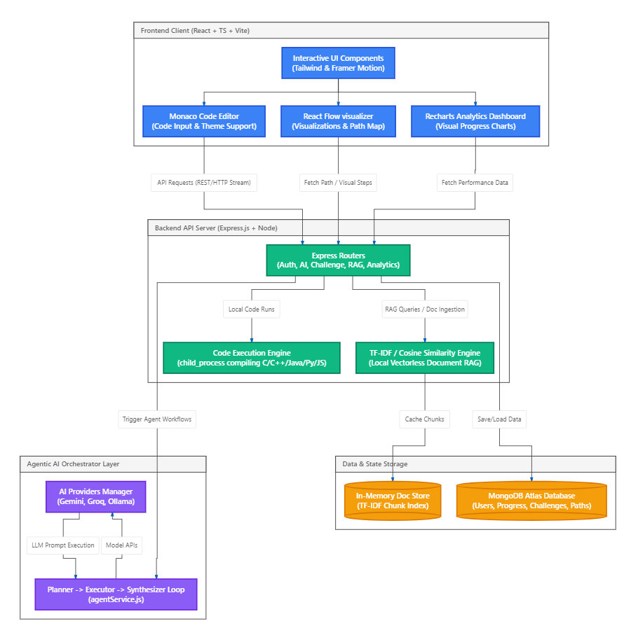
3. Architectural Design
  3.3 Project Architecture
  3.3.1 Architectural Diagram

Slide 10
Architectural Diagram:
Actors:
Learner (Student): Uses the platform to practice coding, learn concepts, and complete assessments.
Teacher/Admin: Manages learning content and monitors student progress.
AI Agent System: Provides intelligent assistance, code analysis, and personalized learning support.
Code Execution Sandbox: Compiles and executes code securely while returning execution results and errors.
Core Use Cases:
Register & Onboard: Completes registration and a pre-assessment to receive a personalized learning path.
Practice Coding: Writes and executes code in the Monaco Editor with AI-powered feedback and error analysis.
AI Learning Support: Interacts with the AI chatbot to understand programming concepts and solve coding problems.
Complete Challenges & Mock Interviews: Solves AI-generated coding challenges, quizzes, and participates in mock interviews.
Track Progress: Monitors XP, badges, levels, achievements, and overall learning performance through the dashboard.

Slide 11
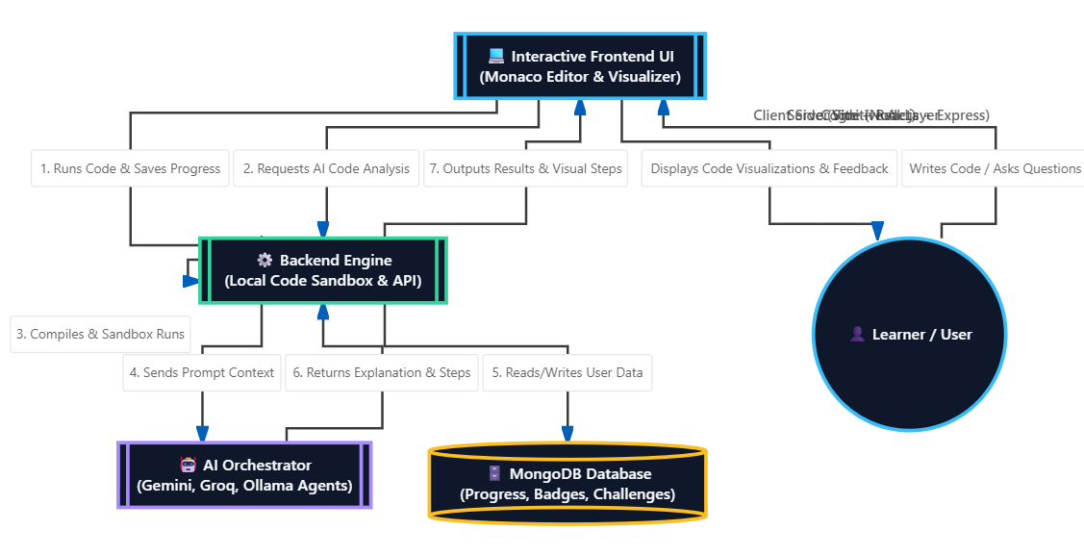
3. Architectural Design
  3.3 Project Architecture
  3.3.2 Data Flow Diagram

Slide 12
Data Flow Diagram:
User Onboarding and Dynamic Profiling: Questionnaire responses flow to the AI Profiling Agent, which updates the user's skill levels in MongoDB and creates a custom learning path.
Code Execution Pipeline: Source code and test inputs flow to the backend, which compiles/interprets the code in a local child-process sandbox and returns stdout/stderr.
Agentic Copilot Feedback Loop: When execution fails, code and error logs are sent to the AI Planner-Executor-Synthesizer loop to compile diagnostic repair advice for the user.
Interactive Step-by-Step Visualization: Code state traces are processed into React Flow arrays to dynamically render visual pointers, trees, and transitions.
AI-Powered Challenge Generation (Nebula Forge): User prompts flow to the AI to create custom JSON challenges containing templates and test cases saved to MongoDB.
Zero-Dependency Local RAG Pipeline: Uploaded PDF/TXT files are chunked and indexed in an in-memory TF-IDF dictionary. The system uses Cosine Similarity to find relevant chunks and grounds the AI response for mock interview Q&A.
Gamification and Leveling Engine: Challenge completion triggers recalculations of user XP, updates level boundaries, grants achievements, and updates the profile dashboard and leaderboard.

Slide 13
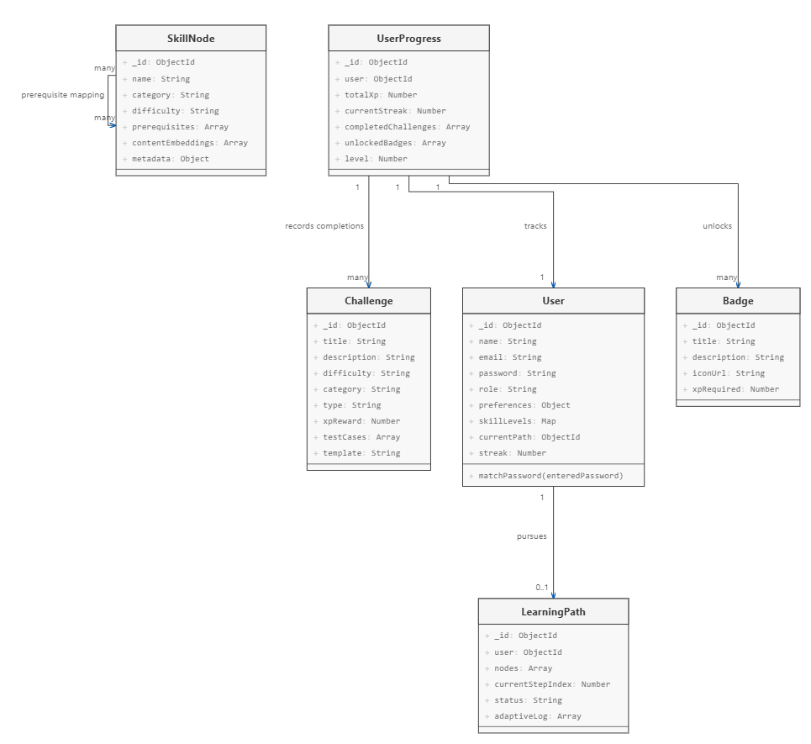
3. Architectural Design
  3.3 Project Architecture
  3.3.3 Class Diagram

Slide 14
Class Diagram:
User Schema: The User model stores authentication credentials, learning preferences, streaks, and a map of topic-wise skill levels.
UserProgress Schema: The UserProgress class links directly to a single User to track their accumulated experience points (XP), current streak, and badges.
LearningPath Schema: The LearningPath class manages a collection of skill nodes assigned to a user, storing progress logs and remedial adjustments.
SkillNode Schema: The SkillNode model defines modular nodes containing categories, difficulty classifications, prerequisites, and metadata.
Challenge Schema: The Challenge class encapsulates program templates, instructions, XP rewards, and input/output assertions for code verification.
Badge Schema: The Badge model represents unlocked rewards, including titles, description criteria, icon locations, and requirements.
Entity Associations: The database references associate users to their paths, link progress logs to completed challenges, and map prerequisite skill trees.

Slide 15
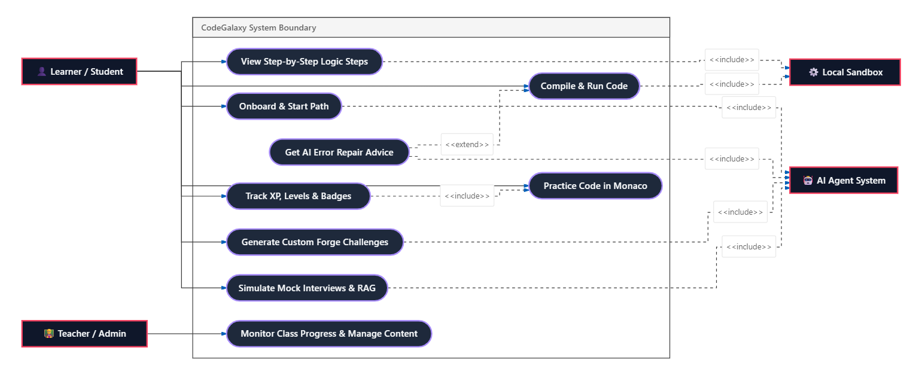
3. Architectural Design
  3.3 Project Architecture
  3.3.4 Use Case Diagram

Slide 16
Use Case Diagram:
Interactive Onboarding: The Learner completes a questionnaire, prompting the AI Agent System to build a tailored skill syllabus.
Standard Sandbox Code Execution: The Learner compiles and executes code inside the Local Sandbox to test standard program outcomes.
Extendable Code Repair: The code execution process extends to trigger the AI Agent System when compilation warnings or execution errors occur.
Logic Step Visualization: The visualizer maps raw execution traces to show step-by-step array transitions, binary search indices, or recursion branches.
On-Demand Challenge Forging: The Learner prompts the AI Agent System to create personalized challenges, including instructions, boilerplates, and verification assays.
Simulated Interview Preparation: The Learner interacts with virtual interviewers to answer technical/behavioral questions backed by a local document RAG retriever.
Educational System Monitoring: The Teacher monitors student progression rates, performance statistics, and levels through a structured supervisor dashboard.

Slide 17
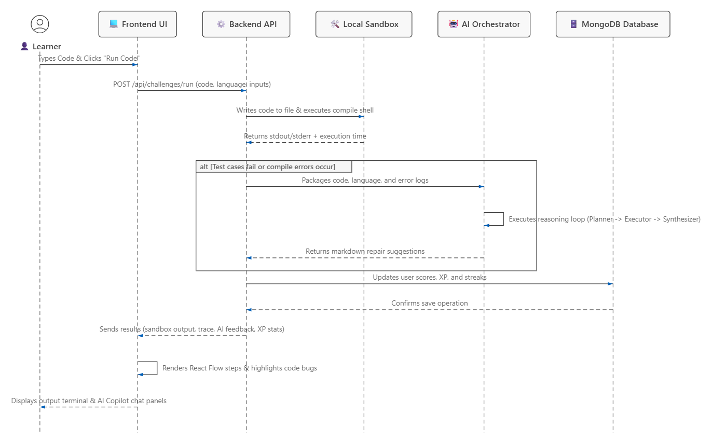
3. Architectural Design
  3.3 Project Architecture
  3.3.5 Sequence Diagram

Slide 18
Sequence Diagram:
Submission Phase: The Learner triggers code submission from the Monaco Editor, transmitting code and language settings to the server.
Sandbox Ingestion: The Backend API maps the code into temporary system files and launches compiler shells (e.g. GCC, Python, or Java) asynchronously.
Execution Reporting: The Local Sandbox captures compilation logs, runtime errors, or program stdout within an 8-second safety timeout.
AI Diagnostic Request: The server automatically routes the code and diagnostic logs to the AI Orchestrator if error logs are detected.
Multi-Agent Reasoning: The AI Orchestrator processes the error logs, planning, compiling, and synthesizing detailed code repair recommendations.
Data Persistence: The server calculates user progression updates, level boundaries, and streak states, saving them in the MongoDB Database.
UI Render and Feedback: The Frontend UI updates user statistics, generates visual state diagrams, and renders interactive feedback cards to the Learner

Slide 19
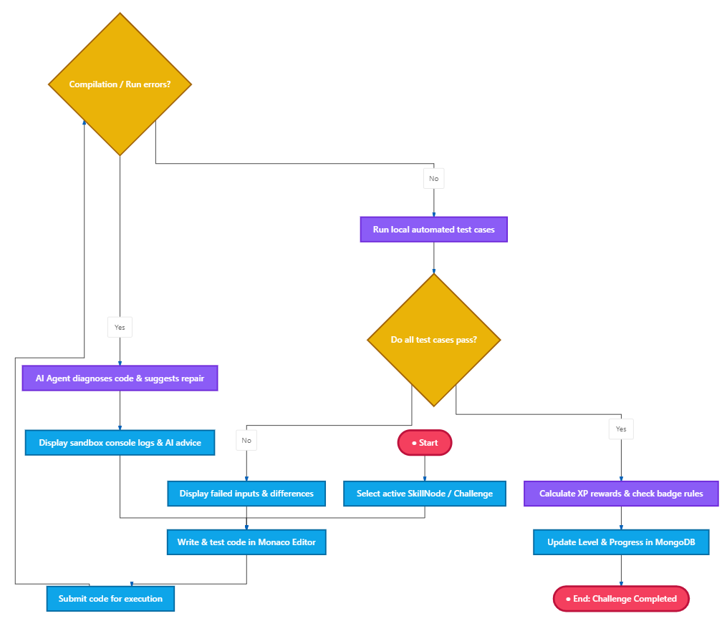
3. Architectural Design
  3.3 Project Architecture
  3.3.6 Activity Diagram

Slide 20
Activity Diagram:
Activity Initialization: The workflow begins when the learner navigates to their dashboard and selects a pending topic or custom challenge.
Standard Sandbox Compilation: Code is submitted to check for syntax issues, compile warnings, or execution limits in the local sandbox.
AI Diagnostics Route: If the system detects execution errors, it triggers the AI Agent to review the code and formulate custom repair tips.
Interactive Iteration Loop: Learners review compiler outputs and AI feedback cards, editing code in a continuous correction loop.
Assertion Verification: Once code compiles cleanly, the engine runs assertions against multiple hidden and visible test cases.
Reward Calculation: Achieving passing assertions launches an automated engine to calculate experience points (XP) and unlock system badges.
Database Synchronization: The activity terminates by saving state changes, updating leaderboards, and unlocking subsequent learning nodes.

Slide 21
Technologies
1. Backend Technologies
Node.js: A JavaScript runtime used for building the server-side application and managing APIs.
Express.js: A web application framework for Node.js, used to build the server and define routes for handling requests.
MongoDB: A NoSQL database used to store user profiles, learning path nodes, completed challenges, and earned badges.
2. Frontend Technologies
React.js: A frontend JavaScript library used for building interactive, component-based user interfaces.
Monaco Editor: A browser-based code editor engine used to provide code editing, syntax highlighting, and themes.
React Flow: A node-based diagramming library used to build interactive, visual learning paths.
3. AI Integration
Gemini & Groq APIs: LLM integration services used to analyze code, explain concepts, and generate custom challenges.

Slide 22
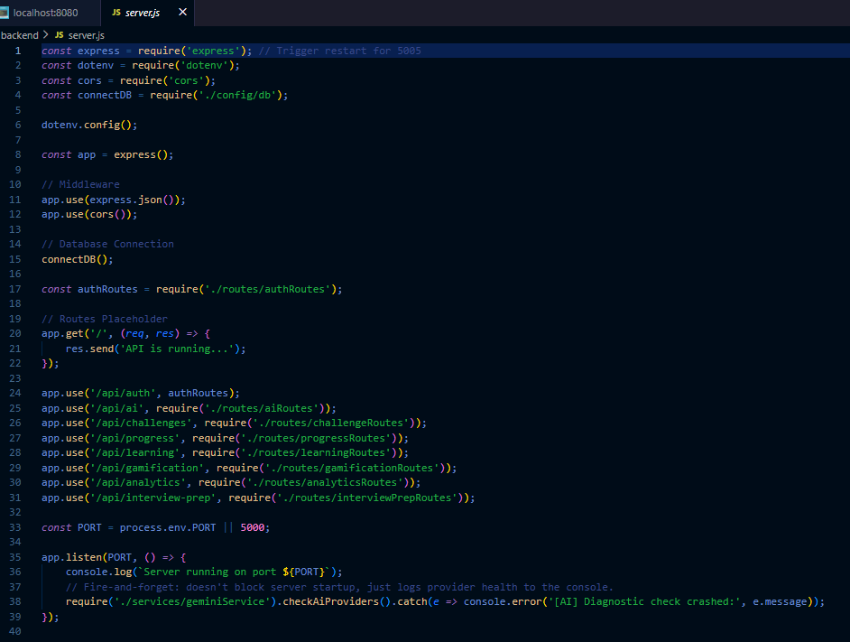
4. Implementation and Testing
  4.1 Coding Blocks

Slide 23
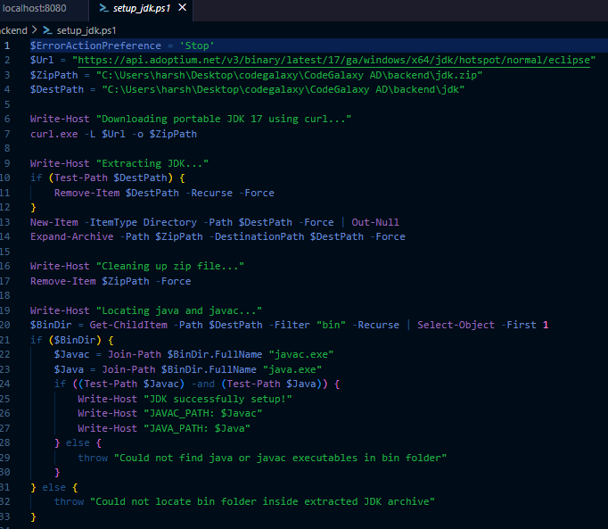
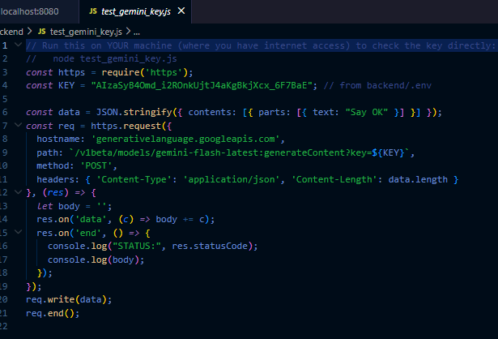

Slide 24
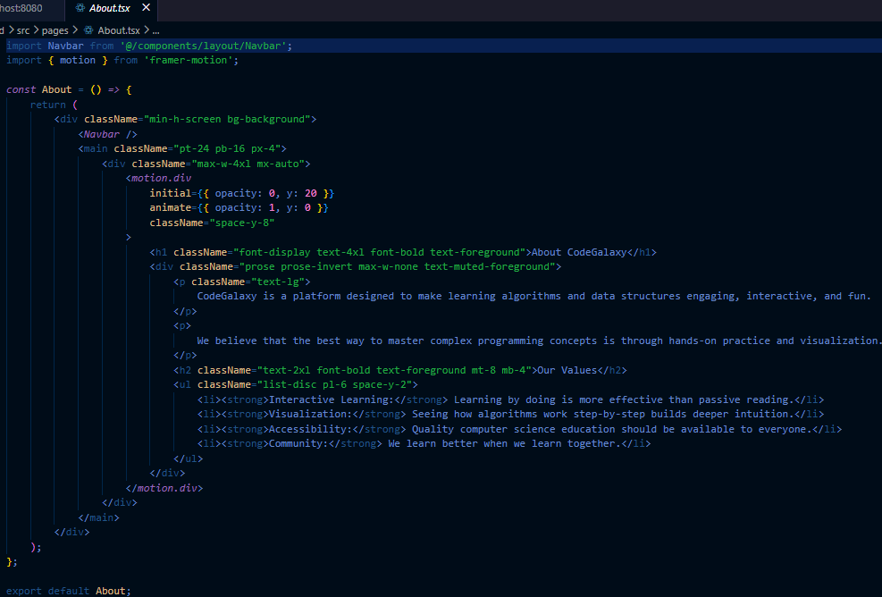
4. Implementation and Testing
  4.2 Sample Code

Slide 25
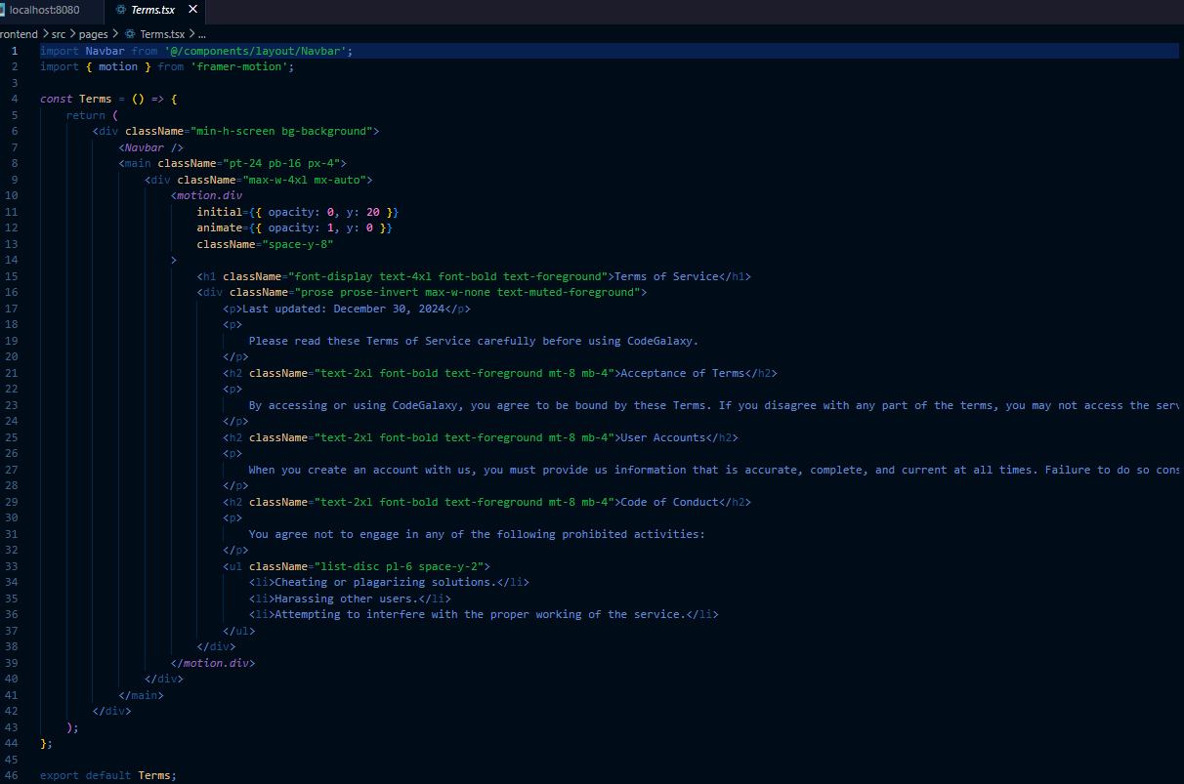

Slide 26
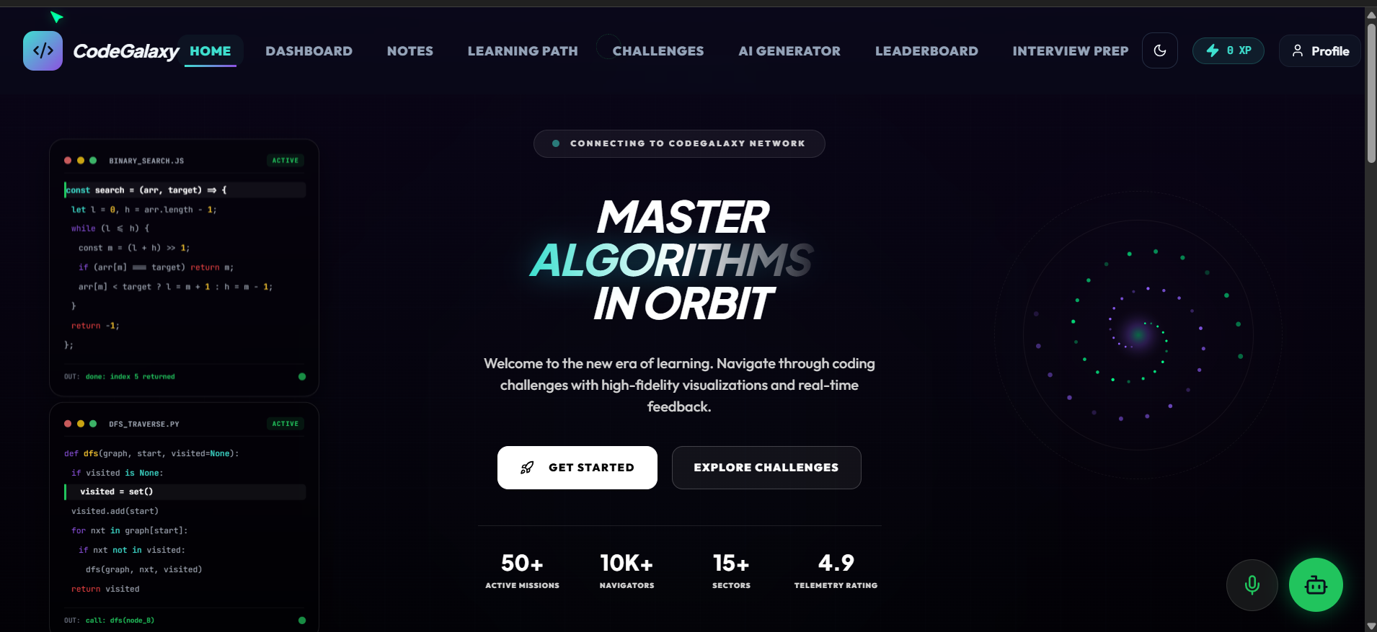
4. Implementation and Testing
  4.3 Execution

Slide 27
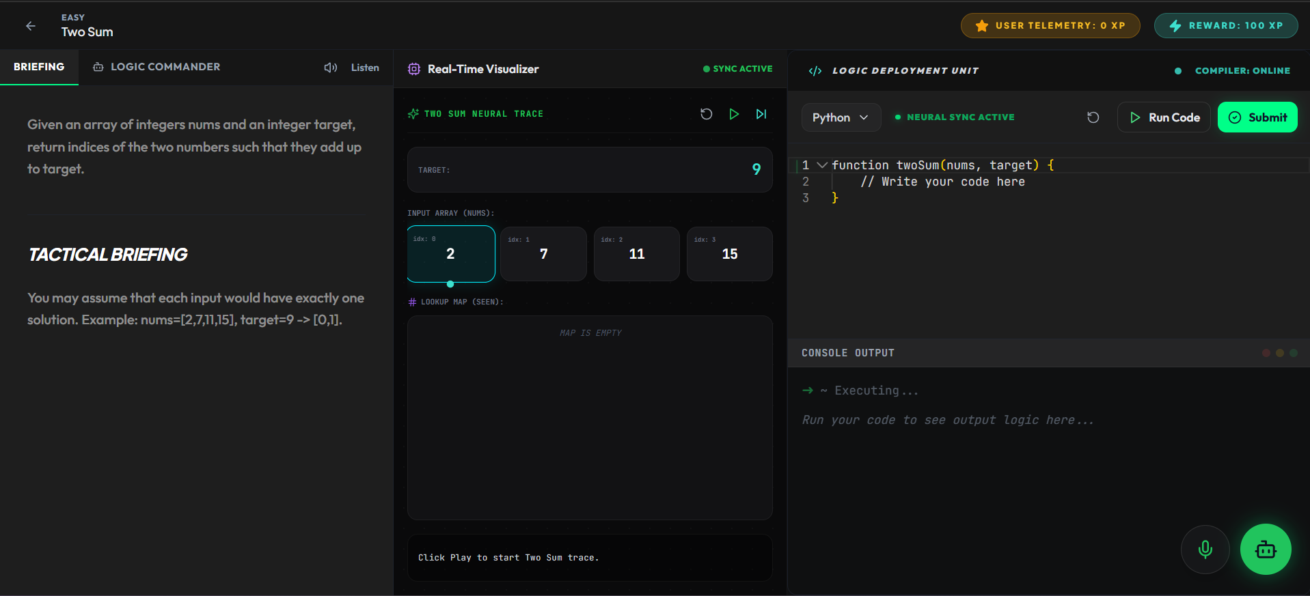

Slide 28
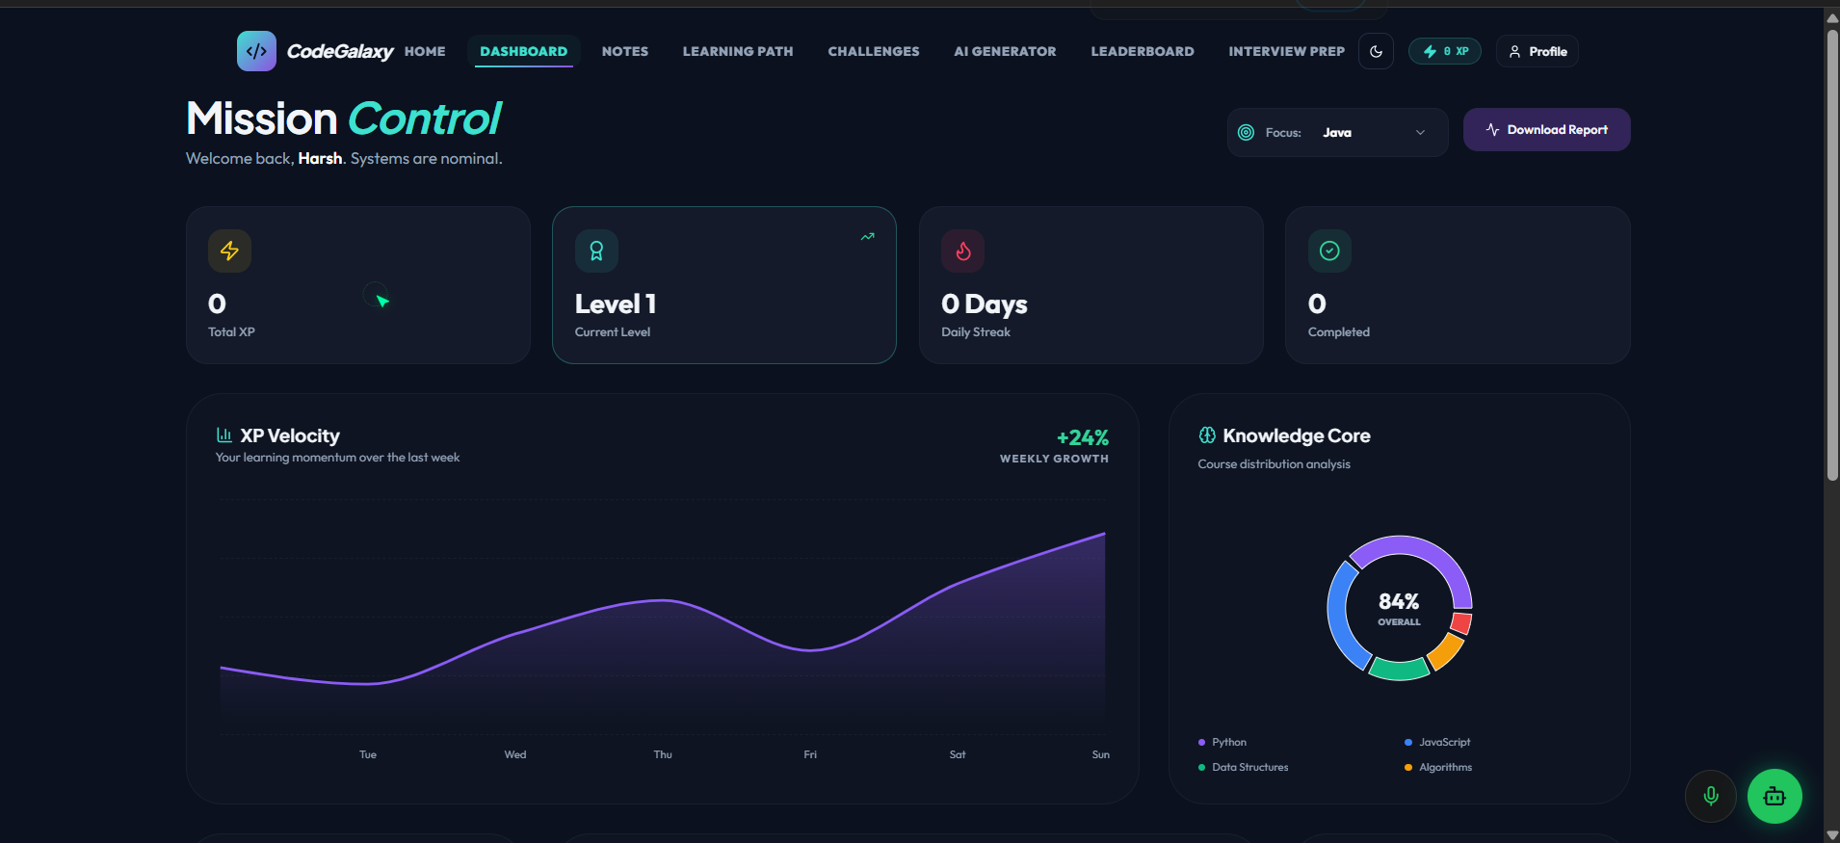

Slide 29
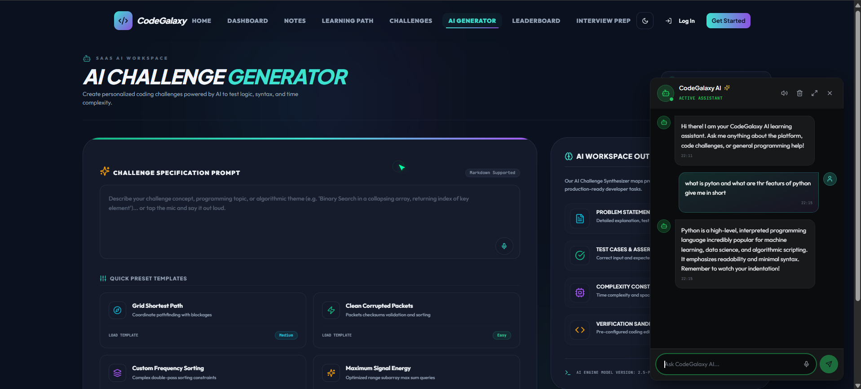

Slide 30
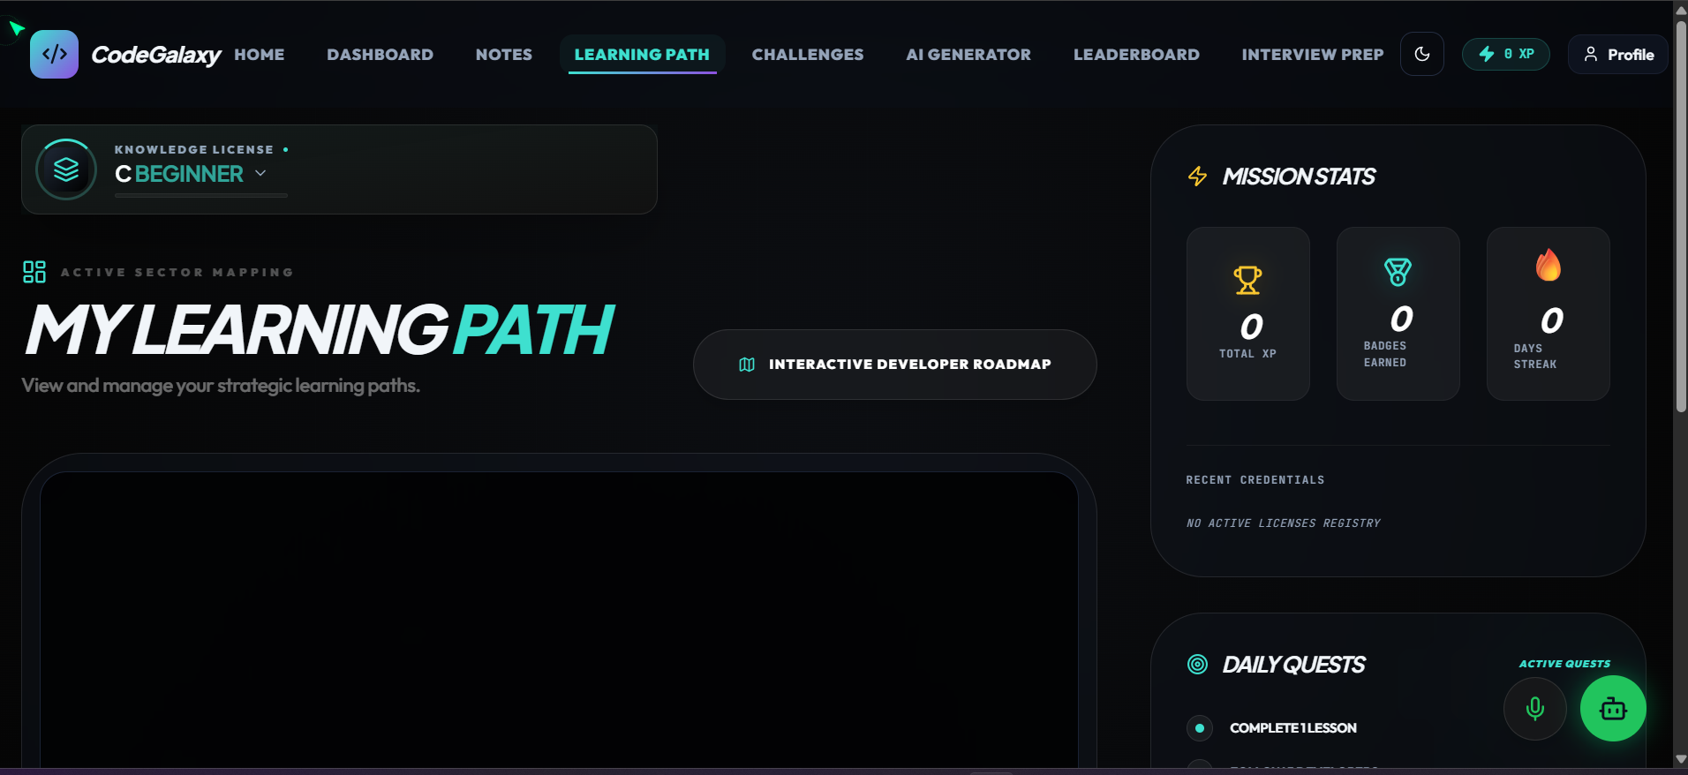

Slide 31

Thank You

